Slide 1
Logistics Data Analysis
Presented by: Avram Darius
Last updated: 13.10.2024

Slide 2
Contents of this presentation
01
02
03
Objective: Improve logistics and optimize supply chain
Data: Using data analysis to uncover the story of the data.
Suggestions/Decisions: Using data to determine important changes that should be made.

Slide 3
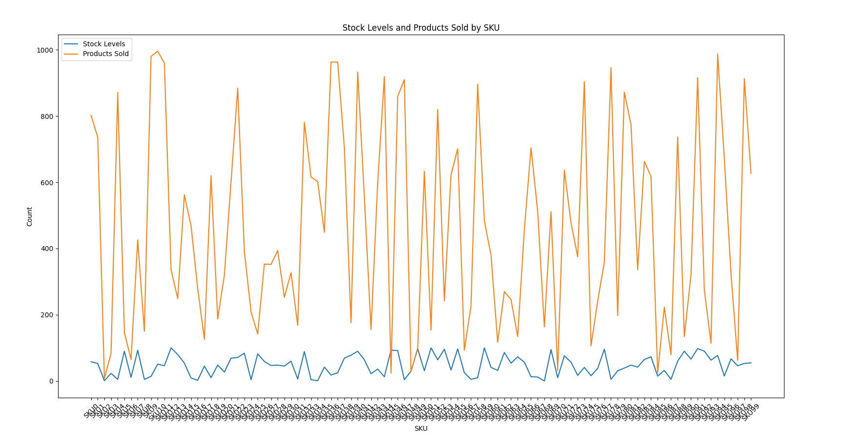
Analysis 1: Stock vs Products Sold
This viz illustrates how big the disparity of stock levels and products sold is.
This should be one of the first things that need fixing, as it causes massive delays.
A list containing which products need more stock to keep up with demand will be attached at the end of the presentation.

Slide 4
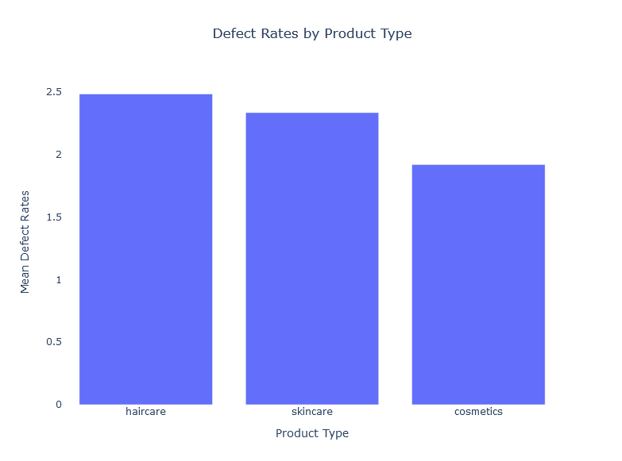
Analysis 2: Defect Rates
This data chart indicates that haircare has the most defect rates.
However, both skincare and cosmetics have pretty high defect rates, this can be a big problem, as customers would have to return a lot of products therefore adding more complexity to the supply chain.

Slide 5
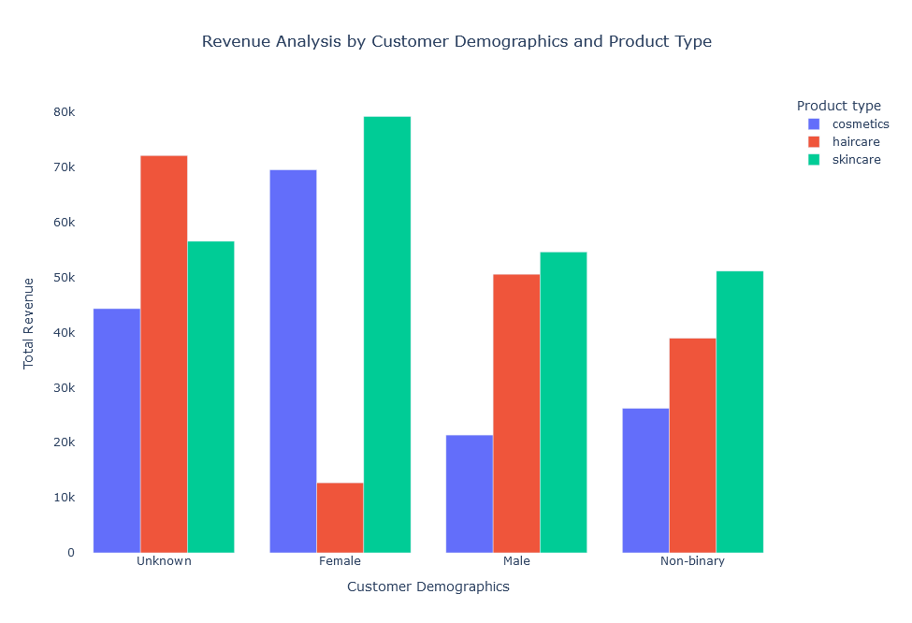
Analysis 3: Demographics
The demographics are important for marketing and overall revenue.
Targeting advertisements to specific demographics(ex:cosmetics to female customers/skincare to men) could drive a massive revenue increase, as this graphic shows.
This can also help with stock, as the database grows, the company will know which customer demographic they have more of and stock accordingly.

Slide 6
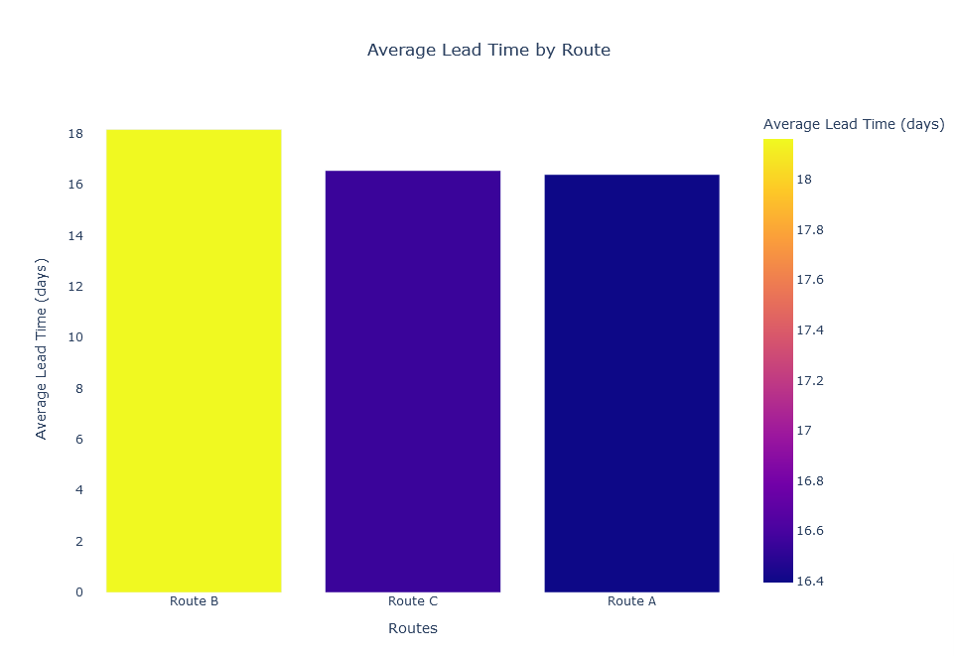
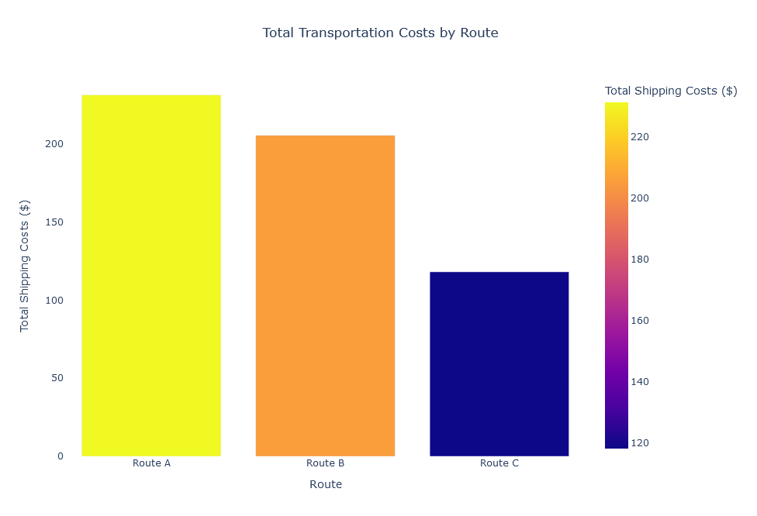
Analysis 4: Route Optimizations
These charts show another issue, even though the time difference between Route A and Route C is almost nothing(about a hour), the cost difference is extreme!
Route A is almost 2 times as expensive as Route C. This is a huge issue that drives costs up and can easily be avoided by opting for route C instead of A.
Route B is the fastest and also isn’t the most expensive, therefore route A does not have much of a reason to exist.

Slide 7
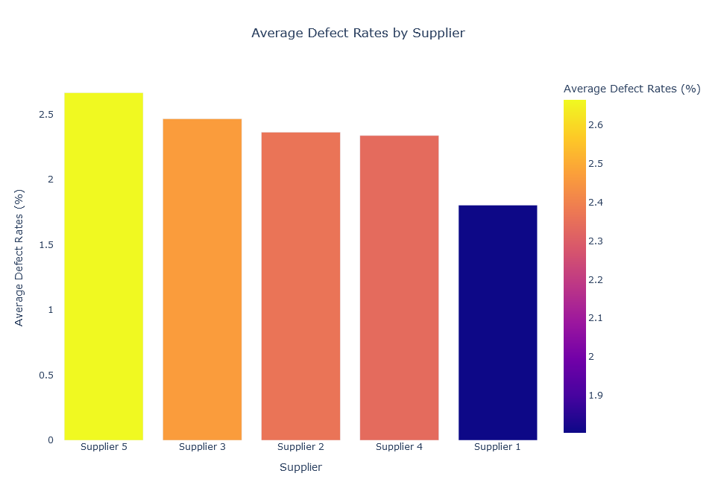
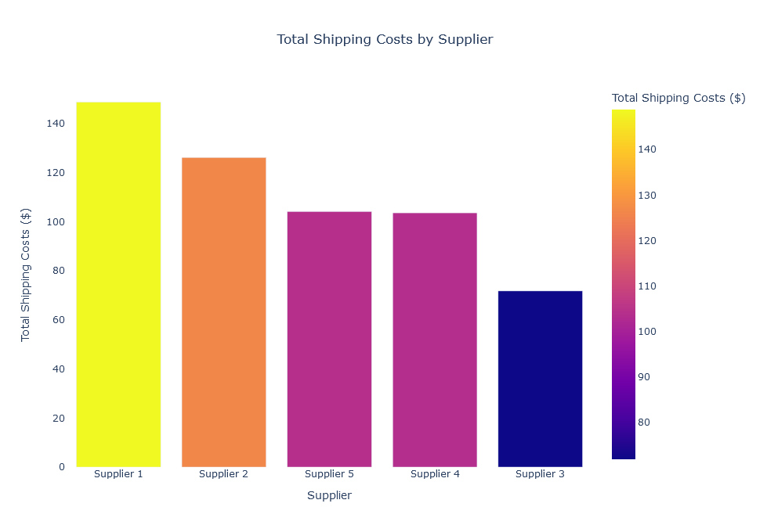
Analysis 5: Suppliers &
defect rates
The problem that I’m seeing is with supplier 5.
While being just as expensive as supplier nr 4, it has the most defects out of all of them!
Unless this supplier is absolutely needed and no other can replace what they sell, there is no reason that the company should be buying from them.

Slide 8
Conclusions/Suggestions:
More stock is needed in order to avoid massive delays and customer complaints.
Contact suppliers and try to figure out why products have big defect rates and figure out a way to lower possible defects.
Use demographics data for targeted marketing, as well as a stock indicator.
Remove/modify Route A so that it makes sense financially.
Talk with supplier 5 and see if they can lower prices, if not find different supplier, they are too expensive for what quality they offer.
List with which stock is needed more: https://docs.google.com/spreadsheets/d/18Sm3zQu_vTEv0_46KqUTj74iTd9LFuZeLNXAsY7v4M0/edit?usp=sharing
I believe that if these suggestions are implemented, the supply chain will get a lot better, customers will be more satisfied and profits will rise.

Slide 9
Thanks!
Do you have any questions?
Contact me at:
avram.dariusalexandru25@gmail.com
+40724086078

